Slide 1
SQL Project Presentation
Ahmed Mohamed Mahmoud Atwa

Slide 2
1. Introduction :-
In this project, we have an ecommerce company's data which includes :-
. User Data : Id , FirstName , LastName , Age , Email , gender , city , country
. Inventory Data : Id , ProductId , Cost , ProductName , ProductCategory
. Product Data : Id , Cost , Category , Name , Brand , Department
. Order Data : OrderId , UserId , Status , Gender ,NumOfItems
. Order Item Data : Id , UserId , ProductId , OrderId , InventoryId , Status

Slide 3
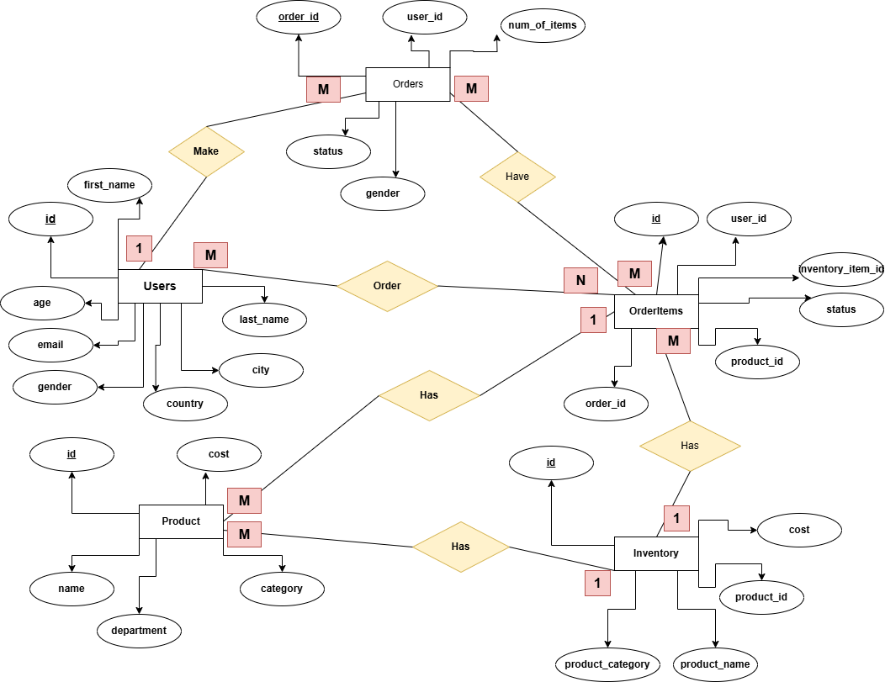
2. Entity Relationship Diagram (ERD) :-

Slide 4
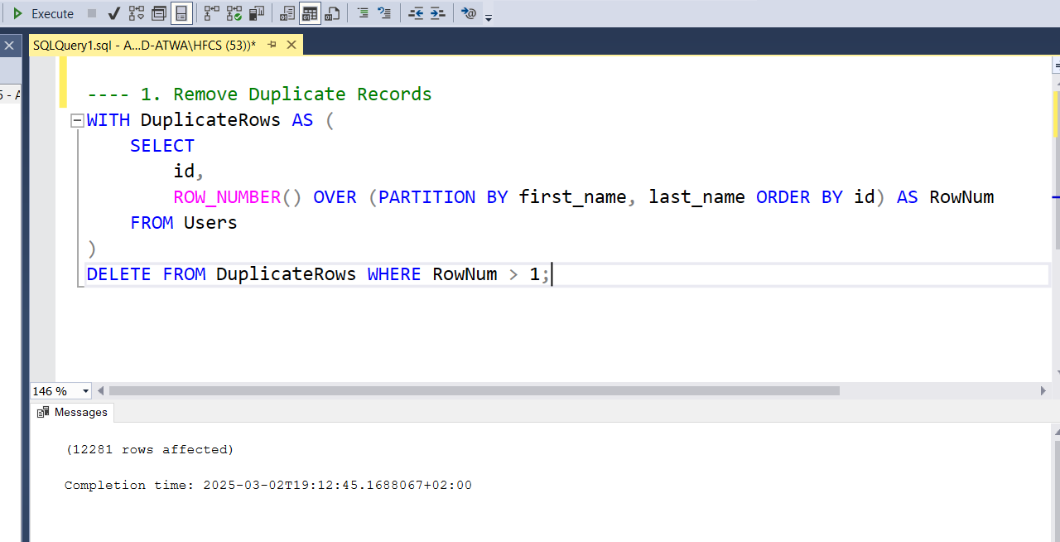
3. Connecting Excel To SQL Server . 4. Cleaning Phase :-

Slide 5
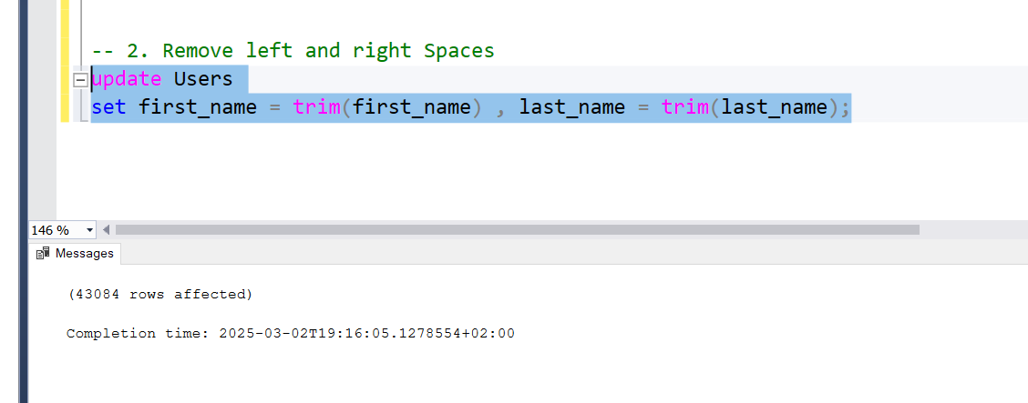

Slide 6
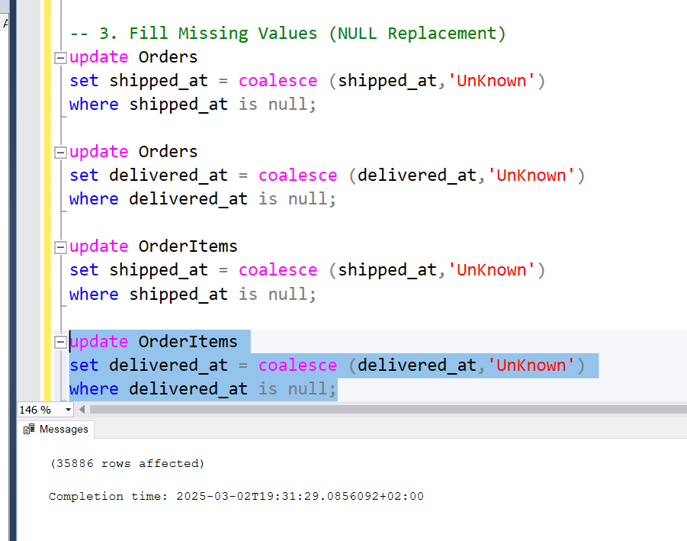

Slide 7
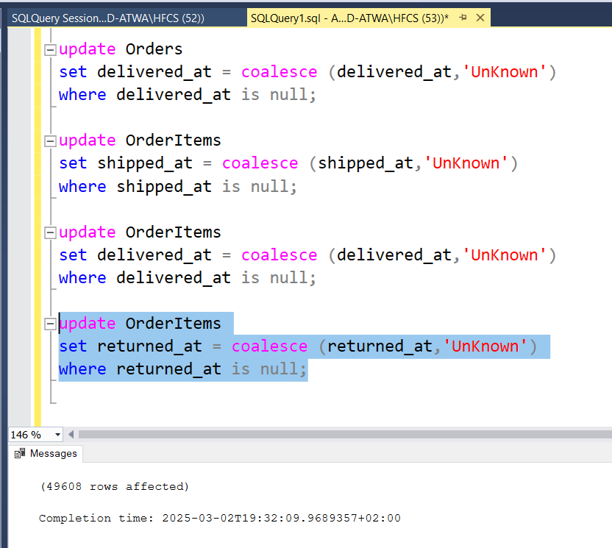

Slide 8
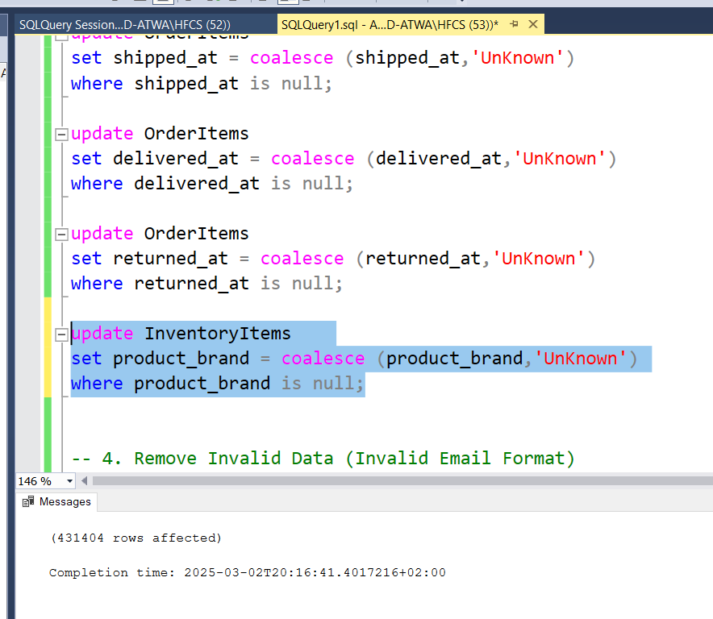

Slide 9
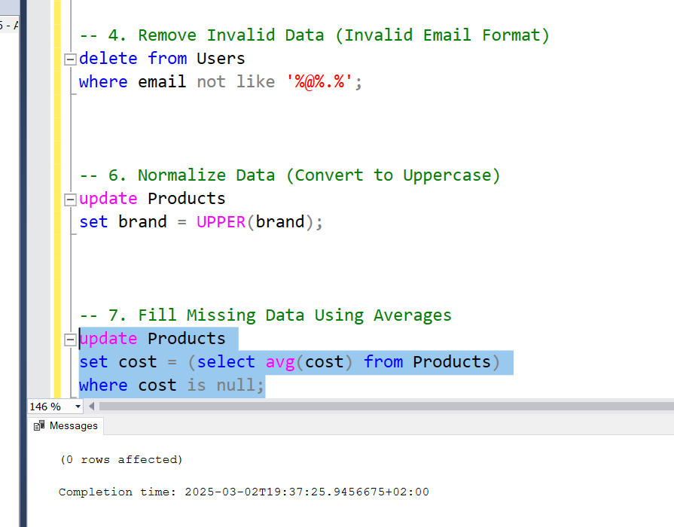

Slide 10
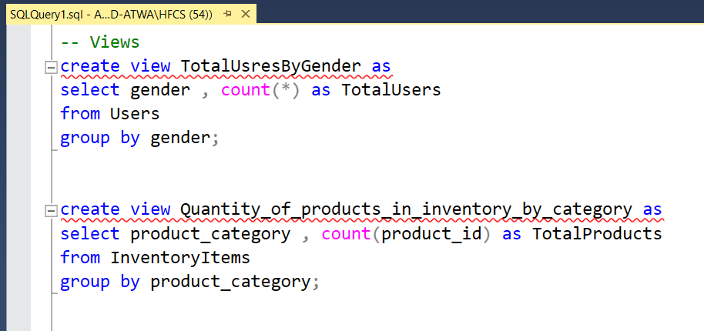
4. Insights :-

Slide 11
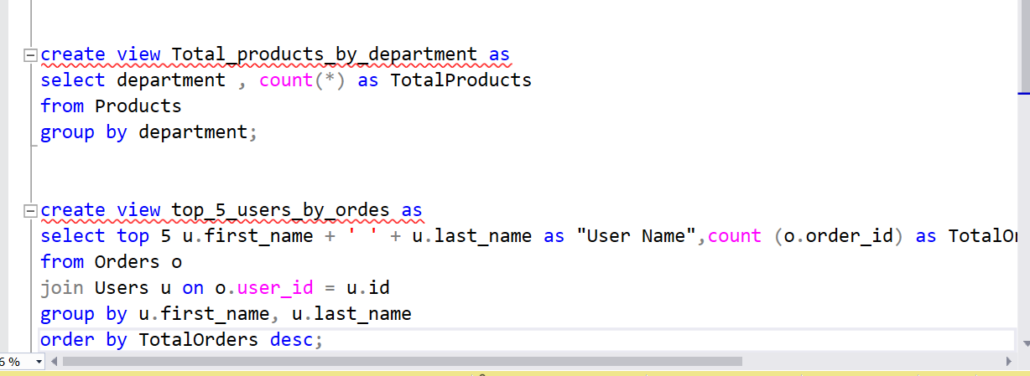

Slide 12
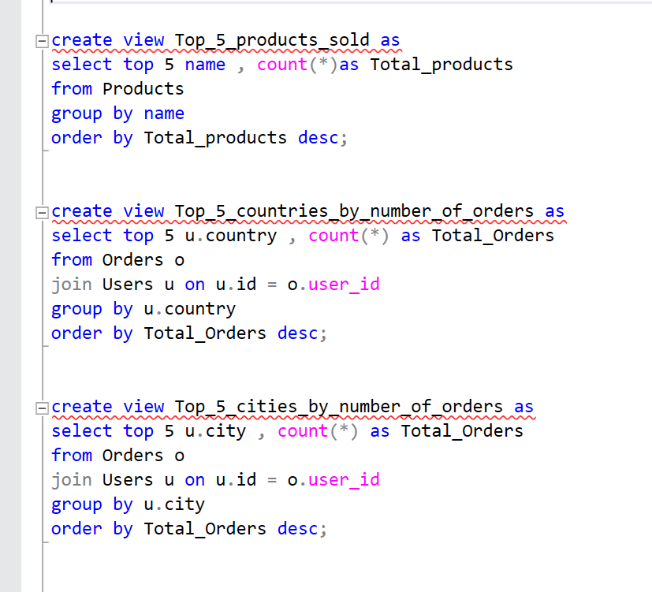

Slide 13
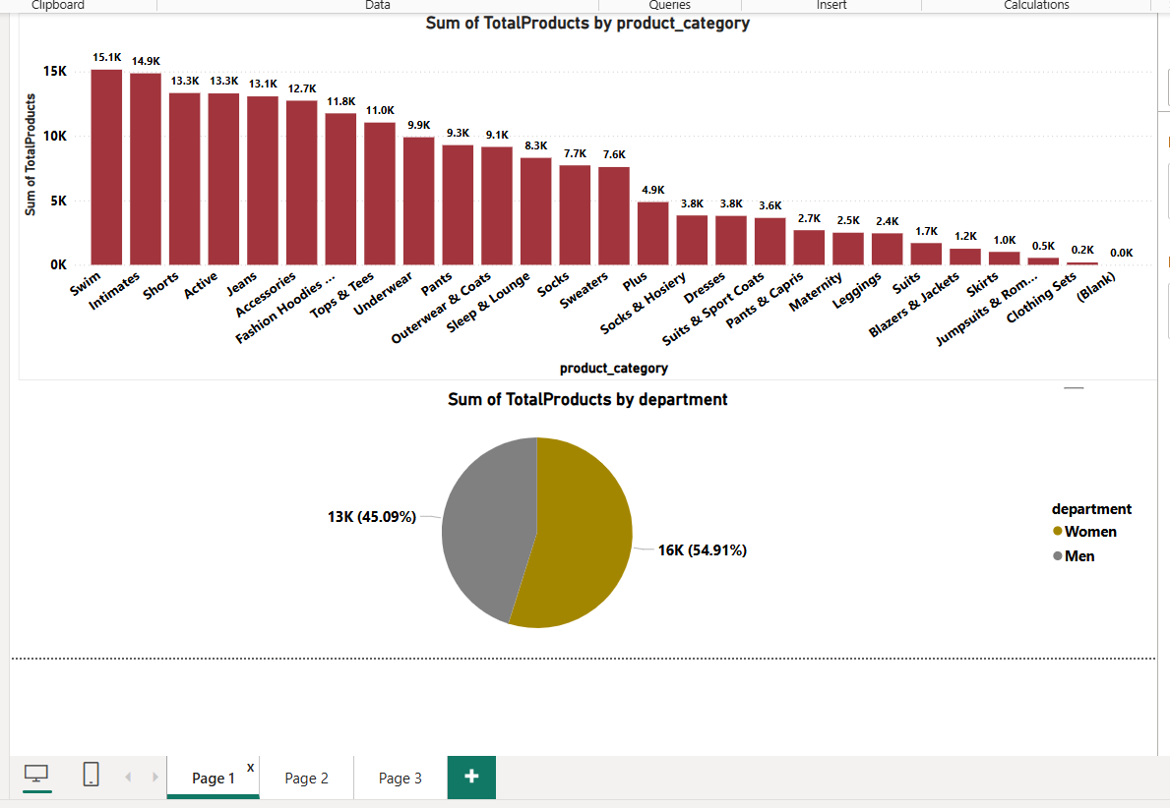
5. Connecting SQL Server To Power BI :-

Slide 14
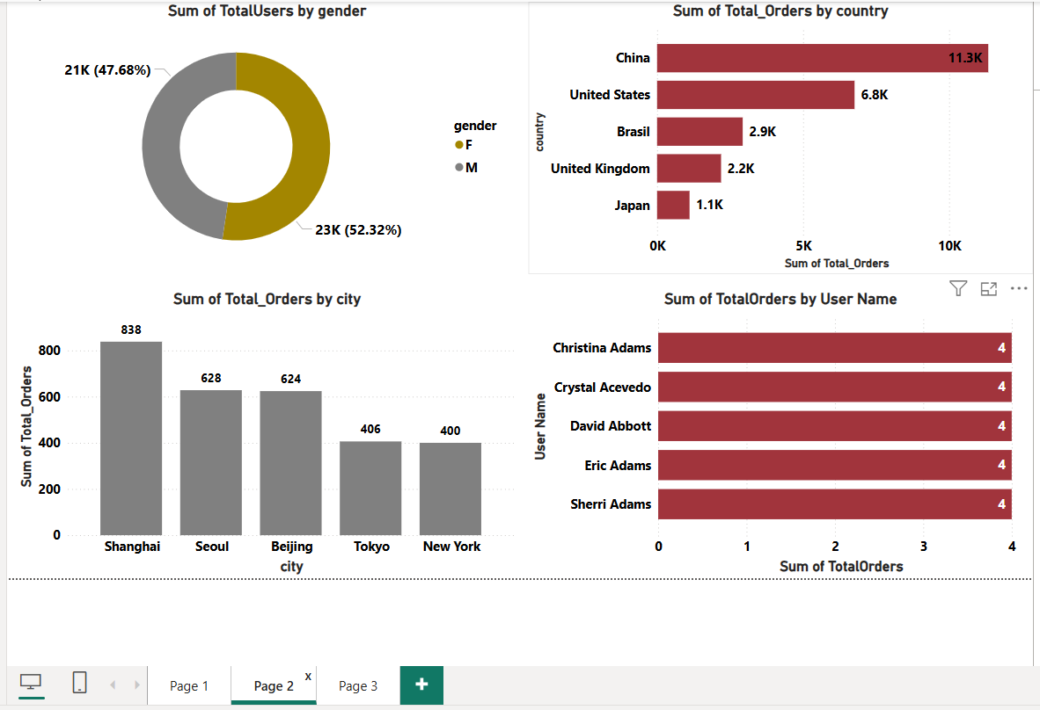

Slide 15
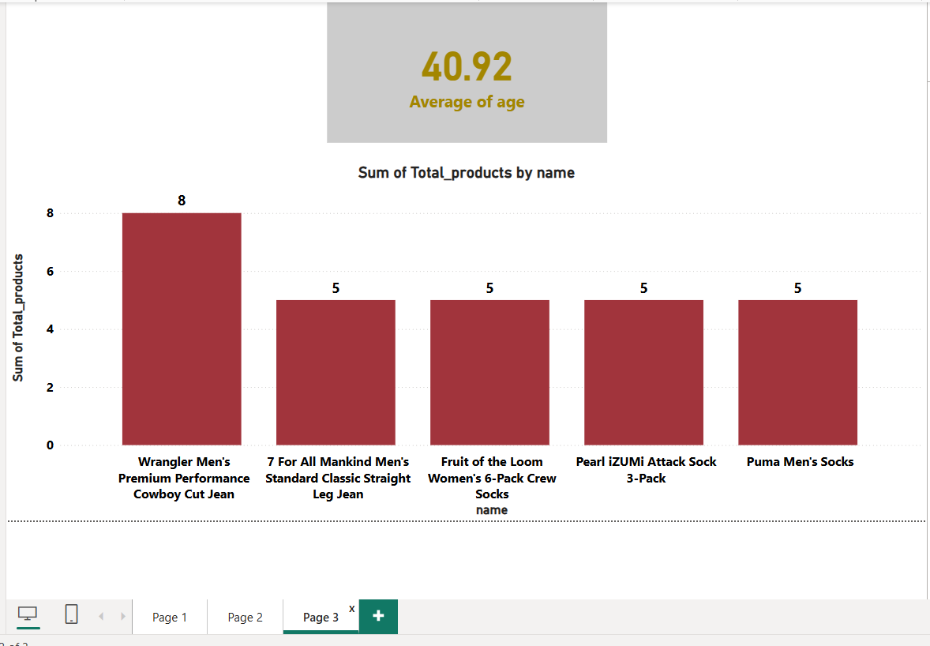

Slide 16
The End

